Slide 1
CODE bakers

Slide 2
About us
At our recipe platform, the QA team ensures a top-notch user experience by rigorously testing all features for functionality, performance, and compatibility. Writing error reports, working in a trustworthy and pleasant working environment with the whole team.
Alina Trečiokė
Vladimir Michailov
Gintaras Jezepčikas
Liucija Ivanauskienė

Slide 3
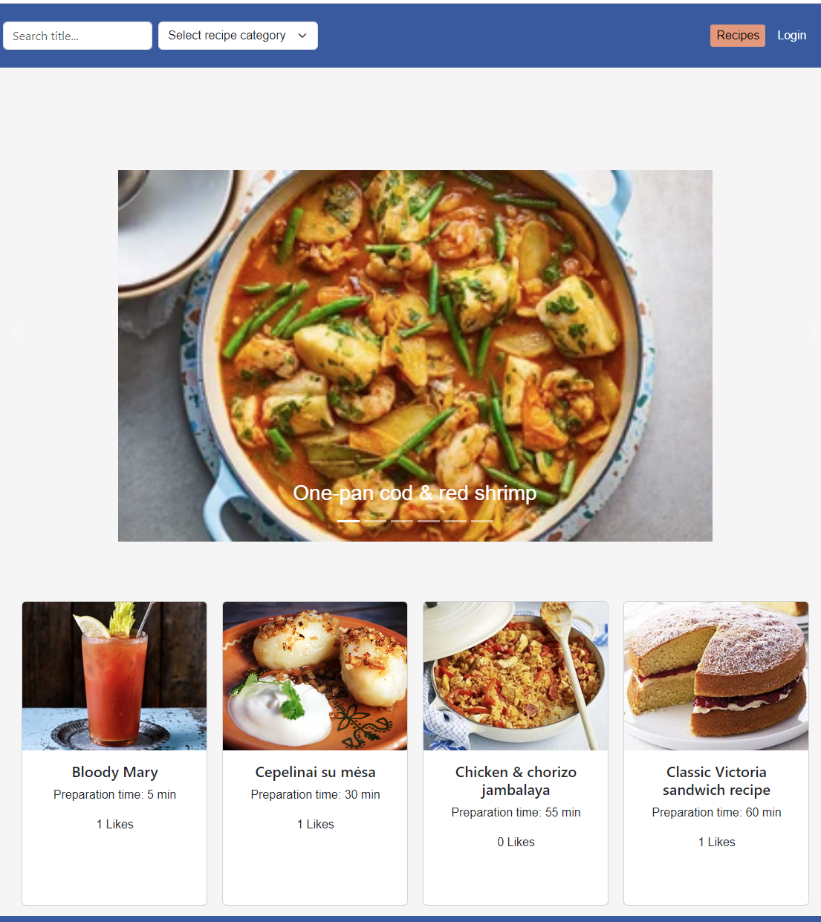
Recipe platform overview

Slide 4
Test Level | Test Types | Testing Technique | Tools used | Description
System Testing | Functional Testing | Experience-based Technique | Manual Testing, Test Cases | Testers interacted with the system as end users, trying out various functionalities and observing the system's behavior.
System Testing | Regression Testing | Automated Testing | Selenium | Involves re-running our test cases from the functional testing phase to ensure that previously developed and tested software still performs after a change. (Not fully tested because of lack of time.)
Integration Testing | Functional Testing | Automated Testing | Postman | Testing the interaction between different components of the software.
Acceptance Testing | User Acceptance Testing (UAT) | Black Box Testing | Manual Testing, Test Cases | The final phase of testing, where actual software users test the software to make sure it can handle.
System Testing | End-to-End Testing | Automated Testing | Selenium | Not enough time to end page development.

Slide 5
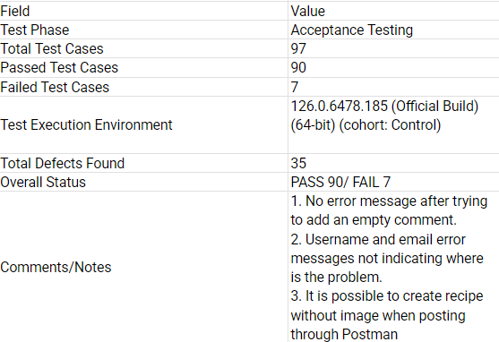
Final Test Summary

Slide 6
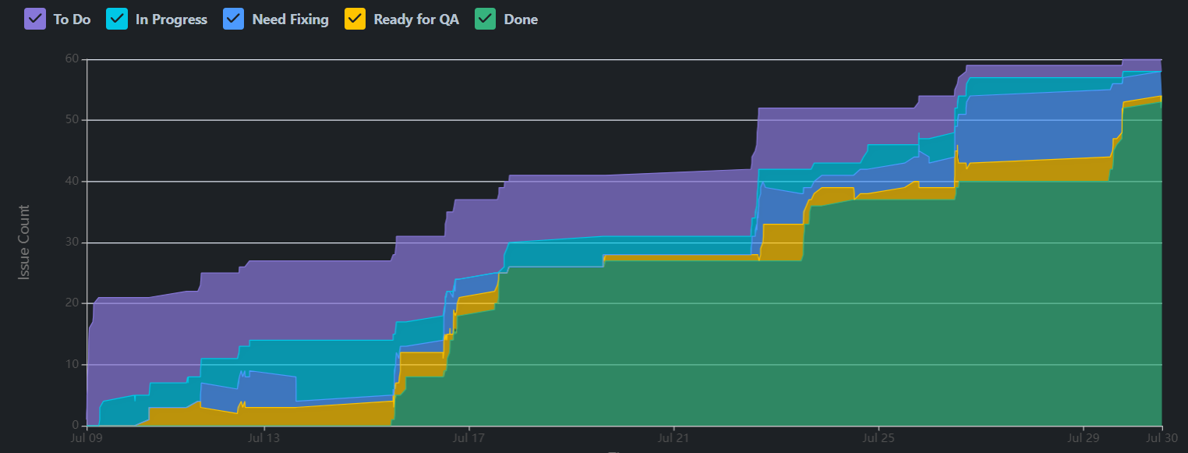
Cumulative flow diagram

Slide 7
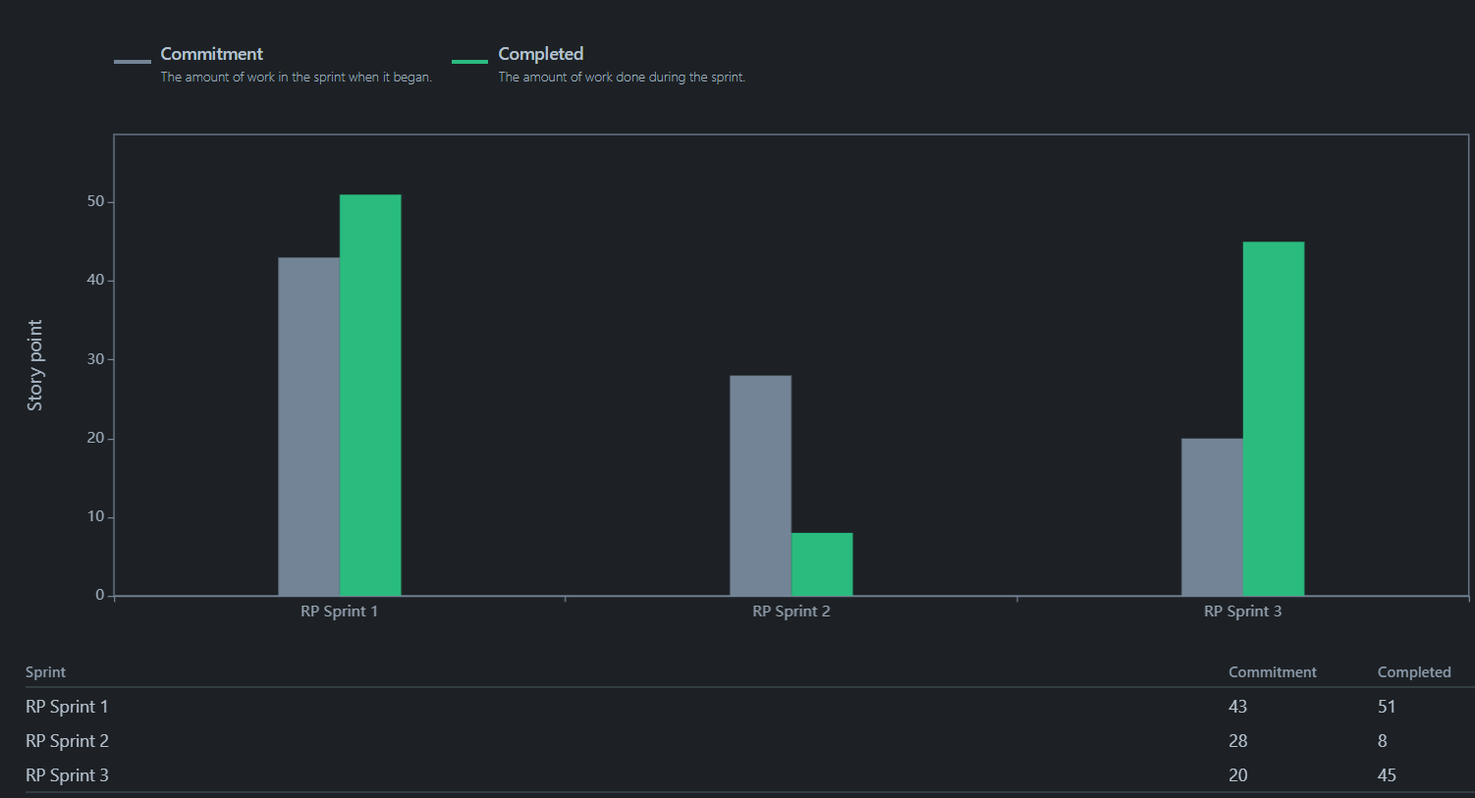
Velocity Report

Slide 8
Project info links
Jira Board
Test Plan Test Cases
GithubQA GithubDEV

Slide 9

Thank you

